Slide 1


DMDD FINAL PROJECT
Moving and Storage Rental Services
Group Number: 1
Team Members ​
Richie John Mathew
Pradnya Kalyan Shinde
Sujendra Jayant Gharat
Rushitha Akula
Ashutosh Vinod Dwivedi

Slide 2

Index:
OBJECTIVES & GOALS
HIGH-LEVEL DESIGN AND APPROACH
E-R Diagram
DATABASE OBJECTS
PRESENTATION LAYER (GUI)
DATA VISUALISATION

Slide 3








OBJECTIVES & GOALS
HIGH LEVEL DESIGN & APPROACH
Key Functionalities:
The primary objective of this project is to establish an advanced inventory management system that optimizes inventory tracking, predicts demand, and seamlessly integrates with rental and sales operations. By efficiently managing stock levels, the system aims to reduce stockouts and leverage data analytics for informed supply chain decisions.
Inventory Management:
Real-time inventory tracking for trucks and trailers.
Advanced tools for demand forecasting and inventory control.
Customer Management:
Database for customer details, preferences, rental history, and feedback.
Personalized services and efficient booking processes.
Online Booking System:
User-friendly platform for online rental bookings.
Real-time integration with inventory for up-to-date availability.
Event-Driven Updates:
Automatic system updates triggered by bookings, returns, and maintenance.
Reward System:
Customers who drop-off trucks or trailers at the suggested locations are rewarded & at the same time, it meets the demand & supply of the highly demanded area.
Operational Analytics:
Analysis of booking trends for resource planning.
Insights into vehicle preference and geographical demand.
Detailed Reports:
Reports on inventory, customer behavior, and financial metrics.

Slide 4
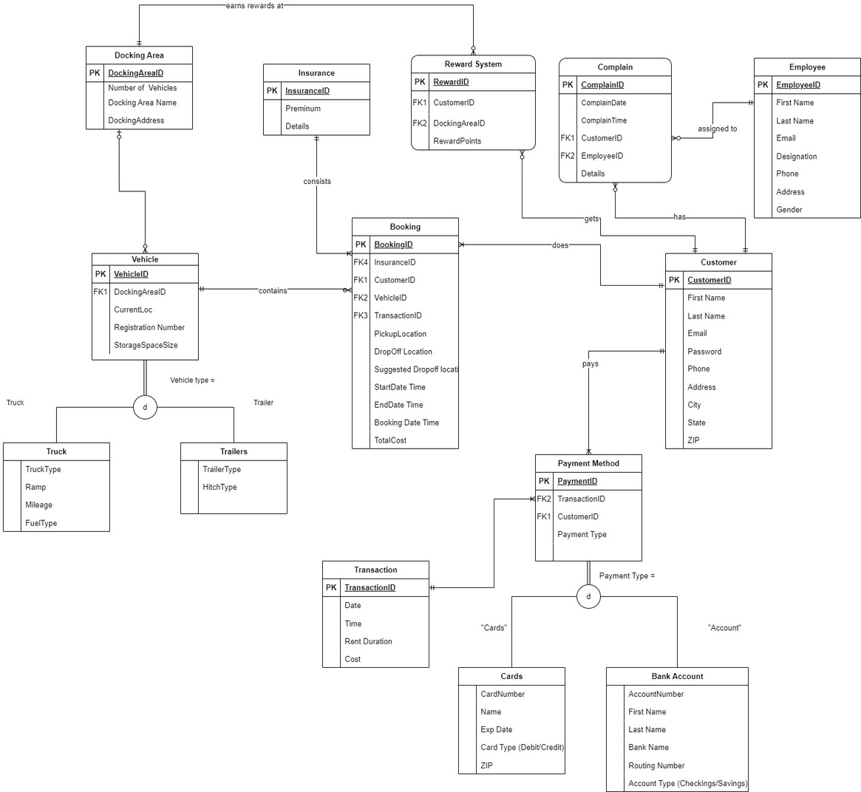
E-R Diagram

Slide 5
Flow chart: HIGH LEVEL DESIGN & APPROACH
No
No
Execute Stored Procedure:
Add Booking
Call UDF:
Calculate the suggested Drop- off location
If vehicle Returns to docking area
Yes
Executed Stored Procedure:
updated vehicle location
Trigger: If
Vehicle location= Suggested drop-off location
Yes
Rewards for Customer
Start
End

Slide 6
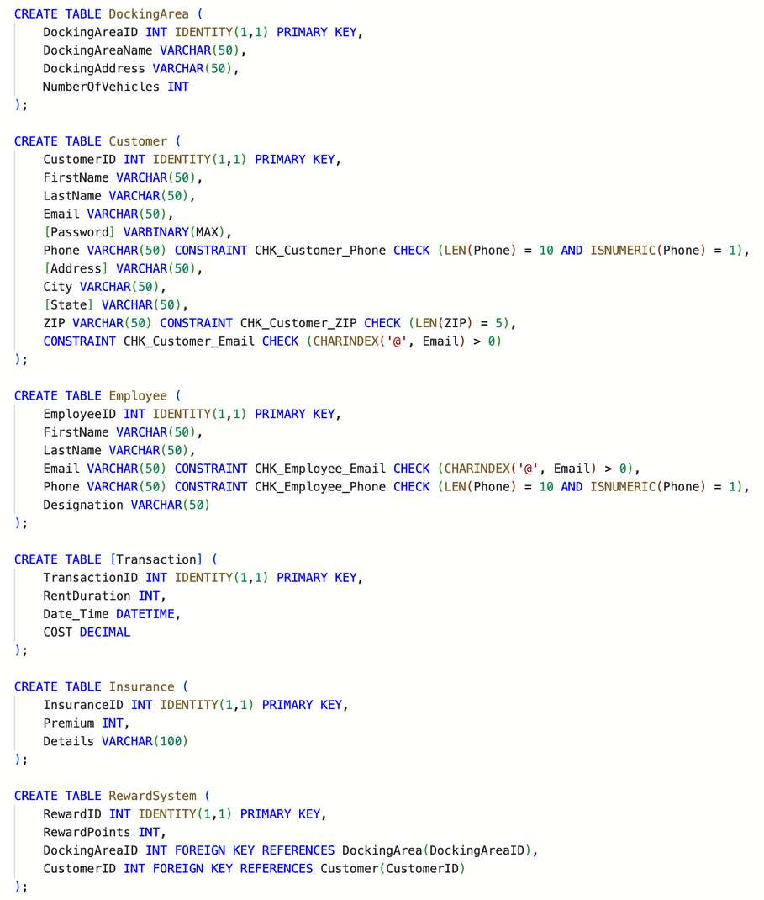
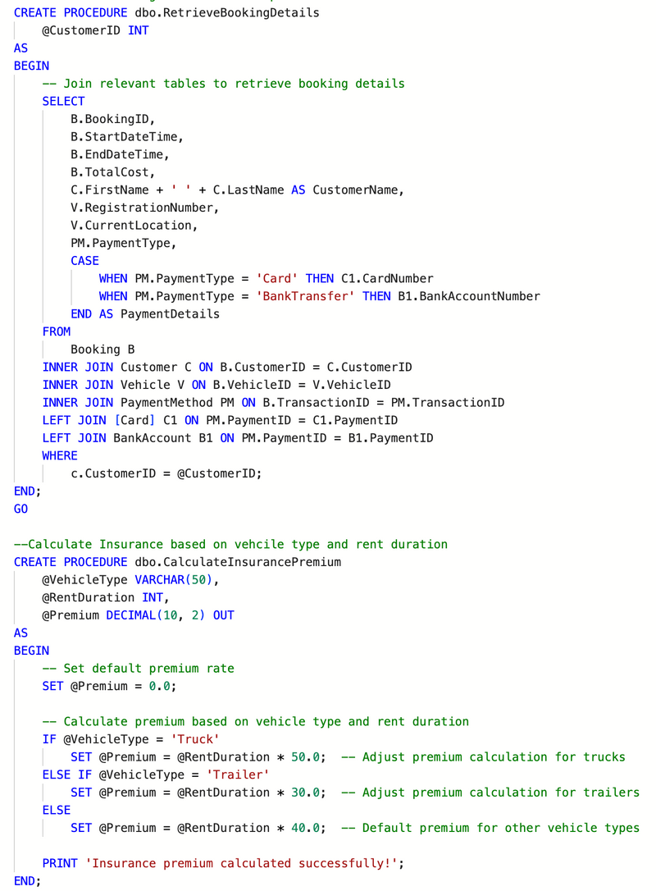
DATABASE OBJECTS
DDLS & INSERT
STORED PROCEDURES

Slide 7
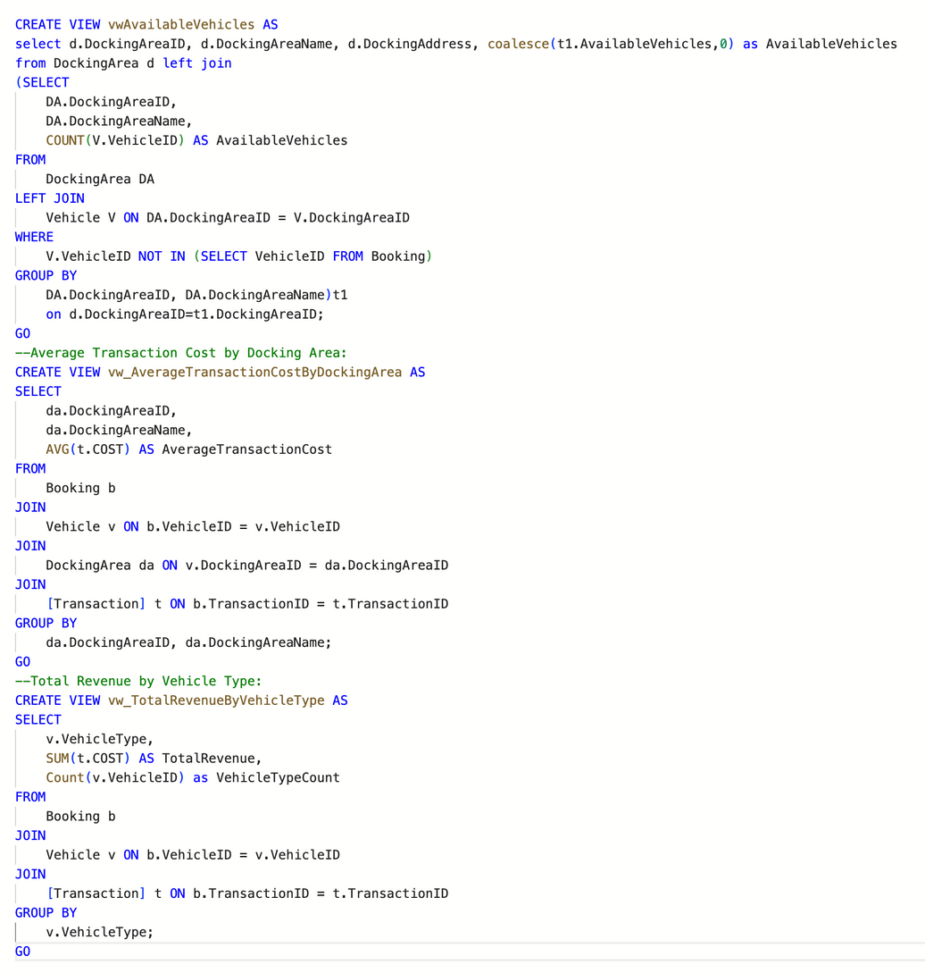
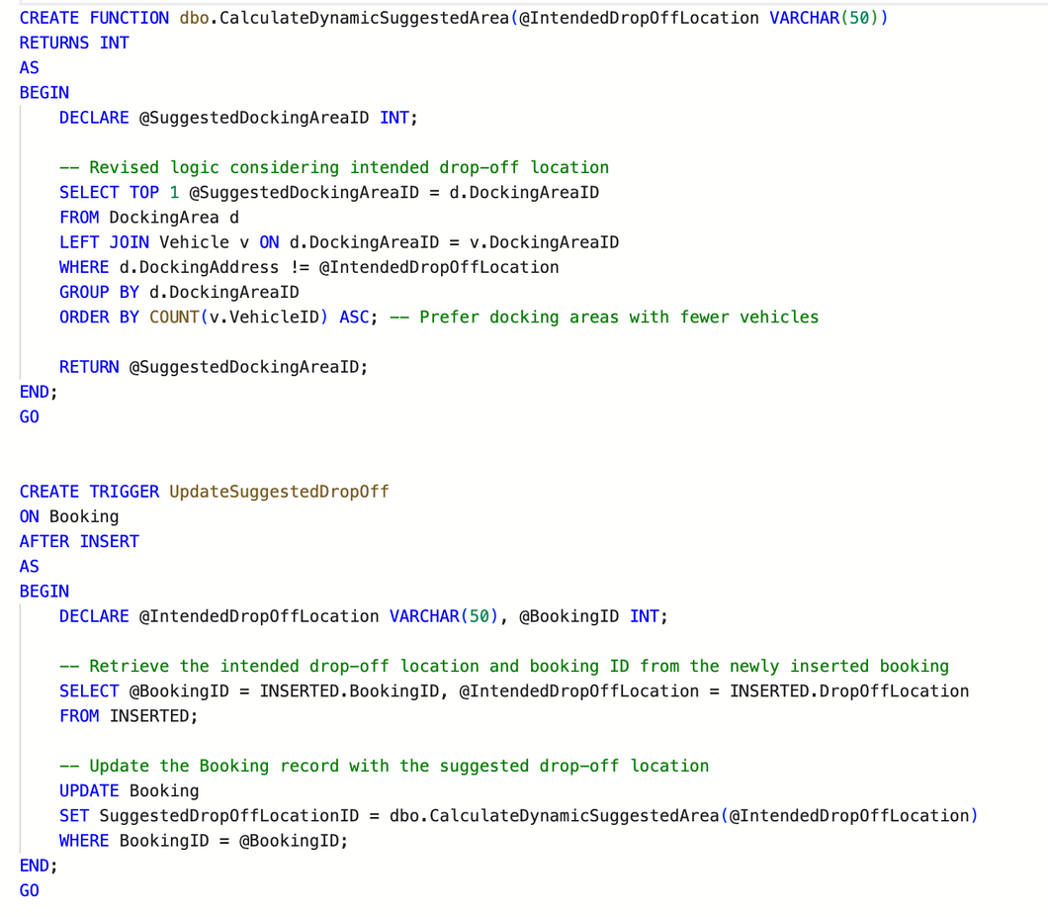
USER DEFINED FUNCTIONS
VIEWS

Slide 8
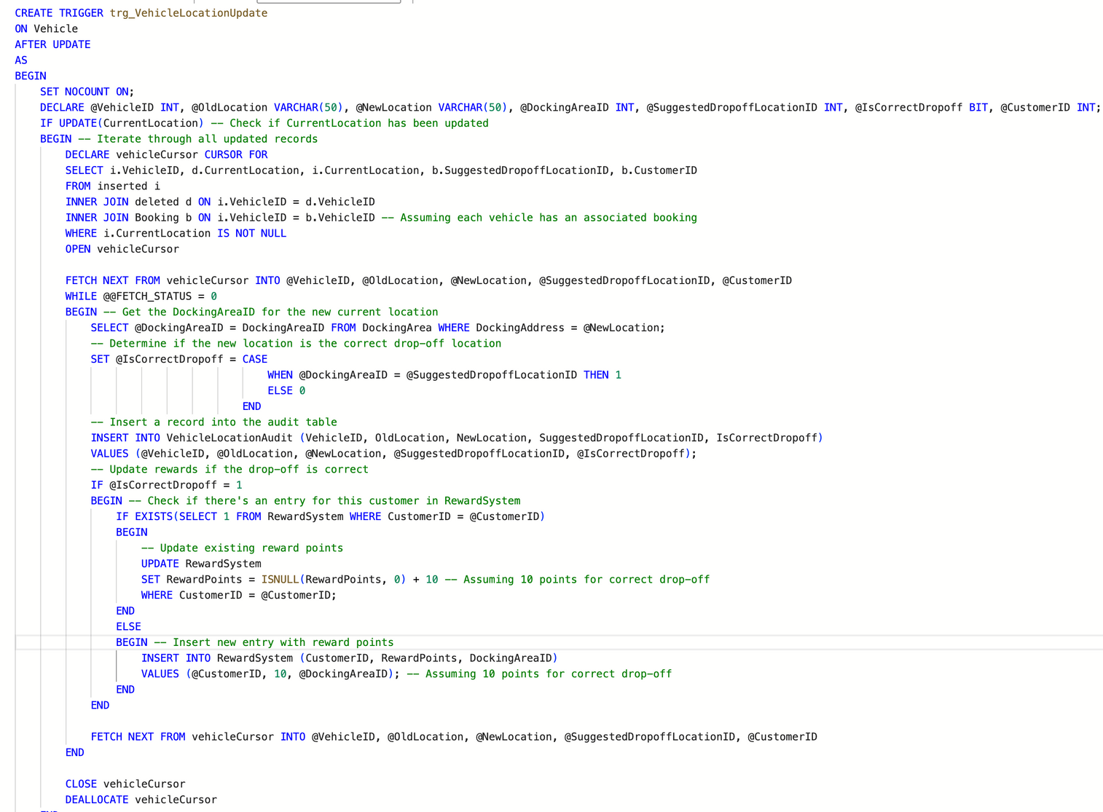
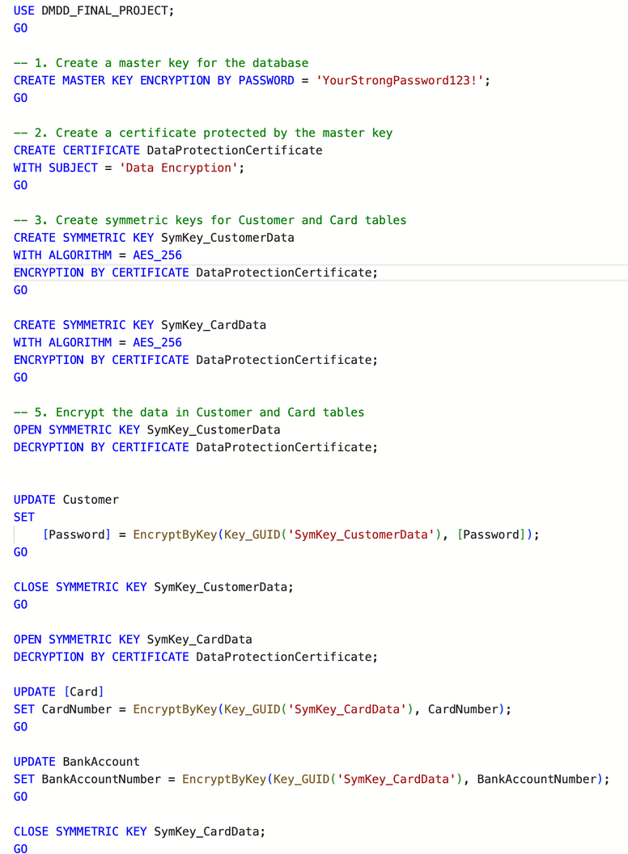
TRIGGERS & INDEXES
DATA ENCRYPTION

Slide 9
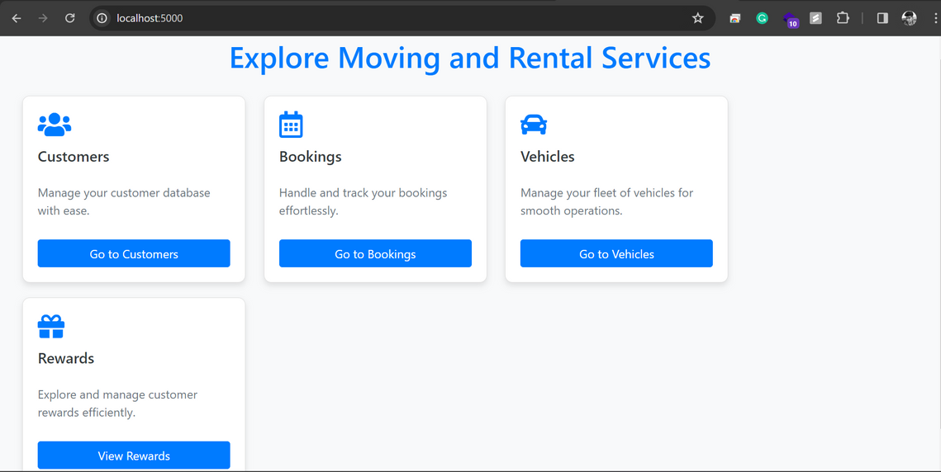
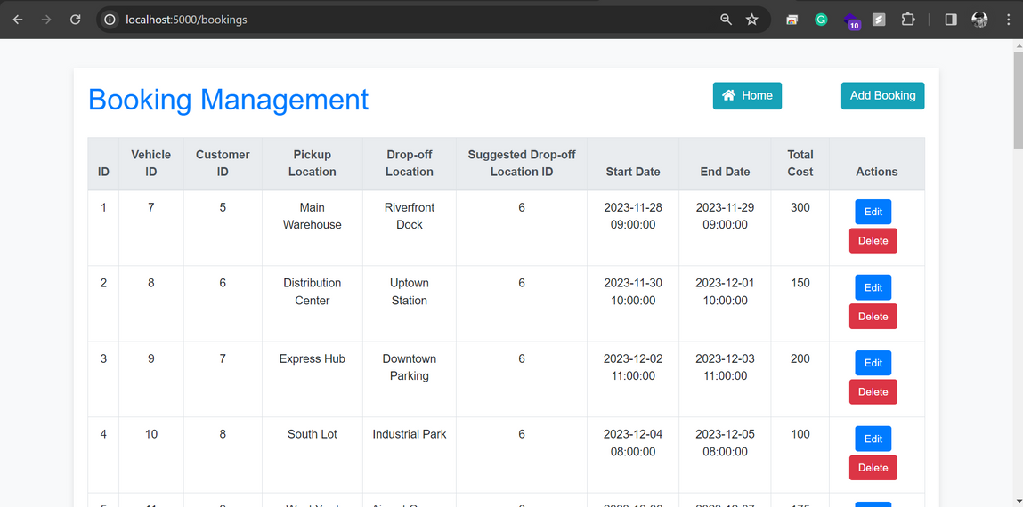
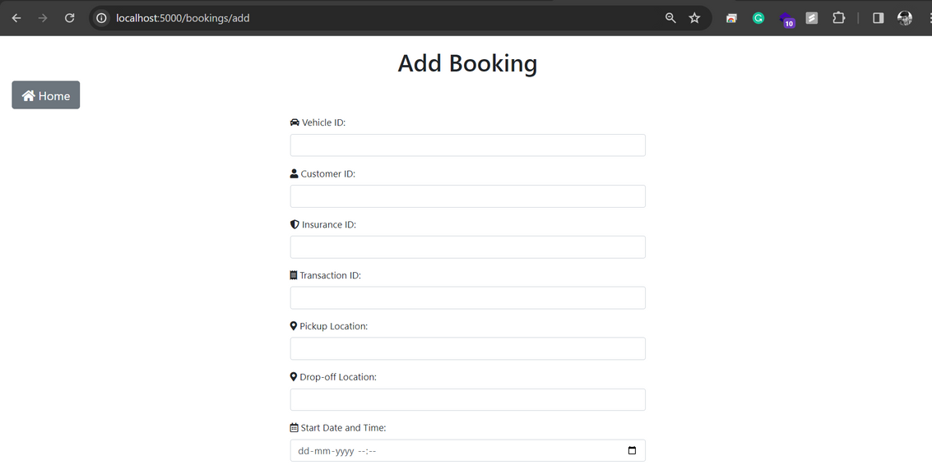
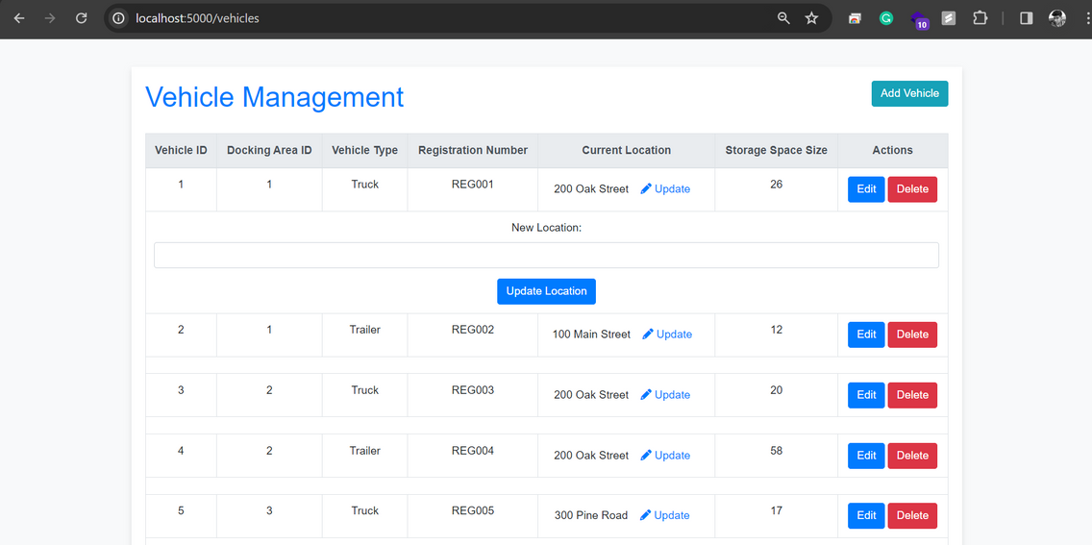
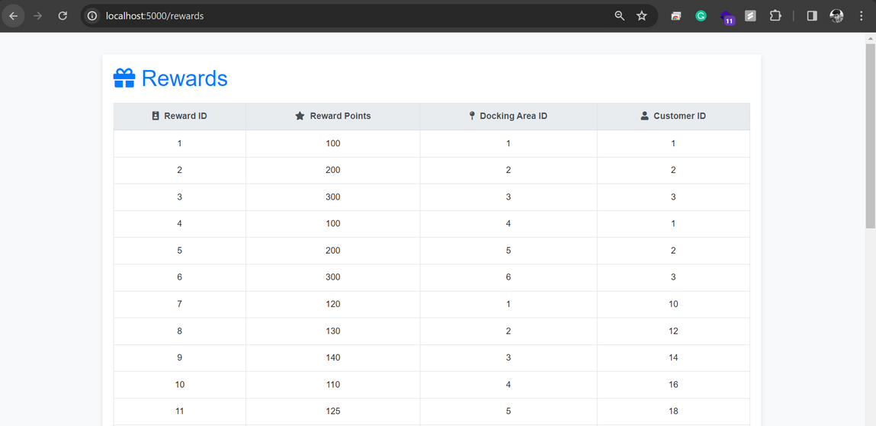
PRESENTATION LAYER (GUI)

Slide 10
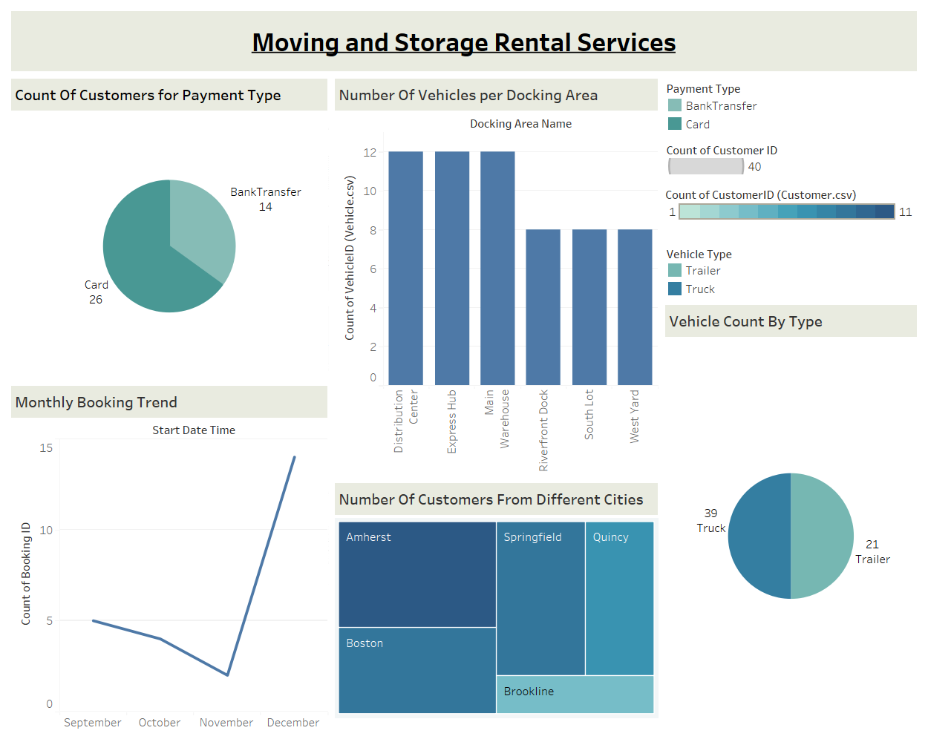
DATA VISUALISATION

Slide 11

Thank You.

